Slide 1
Chapter 24
Numerics
Bjarne Stroustrup
www.stroustrup.com/Programming

Slide 2
Abstract
This lecture is an overview of the fundamental tools and techniques for numeric computation. For some, numerics are everything. For many, numerics are occasionally essential. Here, we present the basic problems of size, precision, truncation, and error handling in standard mathematical functions. We present multidimensional matrices and the standard library complex numbers.
Stroustrup/PPP - Nov'13

Slide 3
Overview
Precision, overflow, sizes, errors
Matrices
Random numbers
Complex numbers
Please note:
  Again, we are exploring how to express the fundamental notions of an application domain in code
    Numerical computation, especially linear algebra
  We are showing the basic tools only. The computational techniques for using these tools well, say in engineering calculations, you’ll have to learn elsewhere
    That’s “domain knowledge” beyond the scope of this presentation
Stroustrup/PPP - Nov'13

Slide 4
Precision, etc.
When we use the built-in types and usual computational techniques, numbers are stored in fixed amounts of memory
  Floating-point numbers are (only) approximations of real numbers
    float x = 1.0/333;
    float sum = 0;
    for (int i=0; i<333; ++i)
    sum+=x;
    cout << sum << "\n"; // 0.999999
  Integer types represent (relatively) small integers only
    short y = 40000;
    int i = 1000000;
    cout << y << " " << i*i << "\n"; // -25536 -727379968
There just aren’t enough bits to exactly represent every number we need in a way that’s amenable to efficient computation
Stroustrup/PPP - Nov'13

Slide 5
Sizes
char
short
int
float
long
int*
double
The exact sizes of C++ built-in types depends on the hardware and the compiler
  These sizes are for Windows using Microsoft , GCC on Linux, and others
  sizeof(x) gives you the size of x in bytes
  By definition, sizeof(char)==1
Unless you have a very good reason for something else, stick to bool, char, int, and double
Stroustrup/PPP - Nov'13

Slide 6
Sizes, overflow, truncation
// when you calculate, you must be aware of possible overflow and truncation
// Beware: C++ will not catch such problems for you
void f(char c, short s, int i, long lg, float fps, double fpd)
{
c = i; // yes: chars really are very small integers (not a good idea)
s = i;
i = i+1; // what if i was the largest int?
lg = i*i; // beware: a long may not be any larger than an int
// and anyway, i*i is an int – possibly it already overflowed
fps = fpd;
i = fpd; // truncates: e.g. 5.7 -> 5
fps = i; // you can lose precision (for very large int values)
char ch = 0; // try this
for (int i = 0; i<500; ++i)
{ cout << int(ch) << "\t"; ++ch; }}
Stroustrup/PPP - Nov'13

Slide 7
If in doubt, you can check
The simplest way to test
  Assign, then compare
    void f(int i)
    {
    char c = i; // may throw away information you don’t want to loose
    if (c != i) {
    // oops! We lost information, figure out what to do
    }
    // …
    }
  That’s what narrow_cast from std_lib_facilities.h does
Stroustrup/PPP - Nov'13

Slide 8
Math function errors
If a standard mathematical function can’t do its job, it sets errno from <cerrno>, for example
  void f(double negative, double very_large)
  // primitive (1974 vintage, pre-C++) but ISO standard error handling
  {
  errno = 0; // no current errors
  sqrt(negative); // not a good idea
  if (errno) { /* … */ } // errno!=0 means ‘something went wrong”
  if (errno == EDOM) // domain error
  cerr << "sqrt() not defined for negative argument\n";
  pow(very_large,2); // not a good idea (and did you spot the bug?)
  if (errno==ERANGE) // range error
  cerr << "pow(" << very_large << ",2) too large for a double\n";
  }
Stroustrup/PPP - Nov'13

Slide 9
Matrices
The standard vector and the built-in array are one dimensional
What if we need 2 dimensions? (e.g. a matrix)
  N dimensions?
A vector (e.g. Matrix<int> v(4) ),
also called a 1-dimensional Matrix,
or even a 1*N matrix
A 3*4 matrix (e.g. Matrix<int> m(3,4) ),
also called a 2-dimensional Matrix
Stroustrup/PPP - Nov'13

Slide 10
Matrices
Matrix<int> m(3,4);
A column
A row
A 3*4 matrix,
also called a 2-dimensional Matrix
3 rows
4 columns
Stroustrup/PPP - Nov'13

Slide 11
C-style multidimensional Arrays
A built-in facility
    int ai[4]; // 1-dimensional array
    double ad[3][4]; // 2-dimensional array
    char ac[3][4][5]; // 3-dimensional array
    ai[1] =7;
    ad[2][3] = 7.2;
    ac[2][3][4] = 'c';
  Basically, Arrays of Arrays
Stroustrup/PPP - Nov'13

Slide 12
C-style multidimensional Arrays
Problems
  C-style multidimensional Arrays are Arrays of Arrays
  Fixed sizes (i.e. fixed at compile time)
    If you want to determine a size at run-time, you’ll have to use free store
  Can’t be passed cleanly
    An Array turns into a pointer at the slightest provocation
  No range checking
    As usual, an Array doesn’t know its own size
  No Array operations
    Not even assignment (copy)
A major source of bugs
  And, for most people, they are a serious pain to write
Look them up only if you are forced to use them
  E.g. TC++PL4, pp. 183-186
Stroustrup/PPP - Nov'13

Slide 13
C-style multidimensional Arrays
You can’t pass multidimensional Arrays cleanly
  void f1(int a[3][5]); // useful for [3][5] matrices only
  Can’t read vector with size from input and then call f1
    (unless the size happens to be 3*5)
  Can’t write a recursive/adaptive function
  void f2(int [ ][5], int dim1); // 1st dimension can be a variable
  void f3(int[ ][ ], int dim1, int dim2); // error (and wouldn’t work anyway)
  void f4(int* m, int dim1, int dim2) // odd, but works
  {
  for (int i=0; i<dim1; ++i)
  for (int j = 0; j<dim2; ++j)
  m[i*dim2+j] = 0;
  }
Stroustrup/PPP - Nov'13

Slide 14
A Matrix library
// on the textbook website: Matrix.h
#include "Matrix.h"
void f(int n1, int n2, int n3)
{
Matrix<double> ad1(n1); // default: one dimension
Matrix<int,1> ai1(n1);
Matrix<double,2> ad2(n1,n2); // 2-dimensional
Matrix<double,3> ad3(n1,n2,n3); // 3-dimensional
ad1(7) = 0; // subscript using ( ) – Fortran style
ad1[7] = 8; // [ ] also works – C style
ad2(3,4) = 7.5; // true multidimensional subscripting
ad3(3,4,5) = 9.2;
}
Stroustrup/PPP - Nov'13

Slide 15
A Matrix library
“like your math/engineering textbook talks about Matrices”
  Or about vectors, matrices, tensors
Compile-time and run-time checked
Matrices of any dimension
  1, 2, and 3 dimensions actually work (you can add more if/as needed)
Matrices are proper variables/objects
  You can pass them around
Usual Matrix operations
  Subscripting: ( )
  Slicing: [ ]
  Assignment: =
  Scaling operations (+=, -=, *=, %=, etc.)
  Fused vector operations (e.g., res[i] = a[i]*c+b[i])
  Dot product (res = sum of a[i]*b[i])
Performs equivalently to hand-written low-level code
You can extend it yourself as needed (“no magic”)
Stroustrup/PPP - Nov'13

Slide 16
A Matrix library
// compile-time and run-time error checking
void f(int n1, int n2, int n3)
{
Matrix<double> ad1(5); // default: one dimension
Matrix<int> ai(5);
Matrix<double> ad11(7);
Matrix<double,2> ad2(n1); // error: length of 2nd dimension missing
Matrix<double,3> ad3(n1,n2,n3);
Matrix<double,3> ad33(n1,n2,n3);
ad1(7) = 0; // Matrix_error exception; 7 is out of range
ad1 = ai; // error: different element types
ad1 = ad11; // Matrix_error exception; different dimensions
ad2(3) = 7.5; // error: wrong number of subscripts
ad3 = ad33; // ok: same element type, same dimensions, same lengths
}
Stroustrup/PPP - Nov'13

Slide 17
A Matrix library
As we consider the matrix (row, column):
a[1][2]
Matrix<int> a(3,4);
a(1,2)
a[0]:
00
01
02
03
a[1]:
10
11
12
13
a[2]:
20
21
22
23
As the elements are laid out in memory ("row-wise"):
00
01
02
03
10
11
12
13
20
21
22
23
Stroustrup/PPP - Nov'13

Slide 18
A Matrix library
void init(Matrix<int,2>& a)
// initialize each element to a characteristic value
{
for (int i=0; i<a.dim1(); ++i)
for (int j = 0; j<a.dim2(); ++j)
a(i,j) = 10*i+j;
}
void print(const Matrix<int,2>& a)
// print the elements of Matrix a, row by row
{
for (int i=0; i<a.dim1(); ++i) {
for (int j = 0; j<a.dim2(); ++j)
cout << a(i,j) << '\t';
cout << '\n';
}
}
Stroustrup/PPP - Nov'13

Slide 19
2D and 3D Matrices
// 2D space (e.g. a game board):
enum Piece { none, pawn, knight, queen, king, bishop, rook };
Matrix<Piece,2> board(8,8); // a chessboard
Piece init_pos[] = { rook, knight, bishop, queen, king, bishop, knight, rook };
// 3D space (e.g. a physics simulation using a Cartesian grid):
int grid_nx; // grid resolution; set at startup
int grid_ny;
int grid_nz;
Matrix<double,3> cube(grid_nx, grid_ny, grid_nz);
Stroustrup/PPP - Nov'13

Slide 20
1D Matrix
Matrix<int> a(10); // means Matrix<int,1> a(10);
a.size(); // number of elements
a.dim1(); // number of elements
int* p = a.data(); // extract data as a pointer to a C-style array
a(i); // i^{th} element (Fortran style), but range checked
a[i]; // i^{th} element (C-style), but range checked
Matrix<int> a2 = a; // copy initialization
a = a2; // copy assignment
a *= 7; // scaling a(i)*=7 for each i (also +=, -=, /=, etc.)
a.apply(f); // a(i)=f(a(i)) for each element a(i)
a.apply(f,7); // a(i)=f(a(i),7) for each element a(i)
b =apply(f,a); // make a new Matrix with b(i)==f(a(i))
b =apply(f,a,7); // make a new Matrix with b(i)==f(a(i),7)
Matrix<int> a3 = scale_and_add(a,8,a2); // fused multiply and add
int r = dot_product(a3,a); // dot product
Stroustrup/PPP - Nov'13

Slide 21
2D Matrix (very like 1D)
Matrix<int,2> a(10,20);
a.size(); // number of elements
a.dim1(); // number of elements in a row
a.dim2(); // number of elements in a column
int* p = a.data(); // extract data as a pointer to a C-style array
a(i,j); // (i,j)^{th} element (Fortran style), but range checked
a[i]; // i^{th} row (C-style), but range checked
a[i][j]; // (i,j)^{th} element C-style
Matrix<int> a2 = a; // copy initialization
a = a2; // copy assignment
a *= 7; // scaling (and +=, -=, /=, etc.)
a.apply(f); // a(i,j)=f(a(i,j)) for each element a(i,j)
a.apply(f,7); // a(i,j)=f(a(i,j),7) for each element a(i,j)
b=apply(f,a); // make a new Matrix with b(i,j)==f(a(i,j))
b=apply(f,a,7); // make a new Matrix with b(i,j)==f(a(i,j),7)
a.swap_rows(7,9); // swap rows a[7] ⬄ a[9]
Stroustrup/PPP - Nov'13

Slide 22
3D Matrix (very like 1D and 2D)
Matrix<int,3> a(10,20,30);
a.size(); // number of elements
a.dim1(); // number of elements in dimension 1
a.dim2(); // number of elements in dimension 2
a.dim3(); // number of elements in dimension 3
int* p = a.data(); // extract data as a pointer to a C-style Matrix
a(i,j,k); // (i,j,k)^{th} element (Fortran style), but range checked
a[i]; // i^{th} row (C-style), but range checked
a[i][j][k]; // (i,j,k)^{th} element C-style
Matrix<int> a2 = a; // copy initialization
a = a2; // copy assignment
a *= 7; // scaling (and +=, -=, /=, etc.)
a.apply(f); // a(i,j,k)=f(a(i,j)) for each element a(i,j,k)
a.apply(f,7); // a(i,j,k)=f(a(i,j),7) for each element a(i,j,k)
b=apply(f,a); // make a new Matrix with b(i,j,k)==f(a(i,j,k))
b=apply(f,a,7); // make a new Matrix with b(i,j,k)==f(a(i,j,k),7)
a.swap_rows(7,9); // swap rows a[7] ⬄ a[9]
Stroustrup/PPP - Nov'13

Slide 23
Using Matrix
See book
  Matrix I/O
    §24.5.4; it’s what you think it is
  Solving linear equations example
    §24.6; it’s just like your algebra textbook says it is
Stroustrup/PPP - Nov'13

Slide 24
Implementing Matrix
A Matrix is a handle
  Controlling access to a sequence of elements
Let’s examine a simplified and improved variant of the idea
  That is, not exactly what’s provided as Matrix.h
  template<class T, int N> class Matrix {
  public:
  // interface, as described
  protected:
  T* elem; // elements stored as a linear sequence
  array<Index,N> extents; // number of elements in each dimension
  };
Matrix
elements
Stroustrup/PPP - Nov'13

Slide 25
Implementing Matrix
Resource management:
  A Matrix must manage the lifetimes of its elements
  Constructors allocate memory for elements and initialize elements
  The destructor destroys elements and deallocates memory for elements
  Assignment copies elements
Matrix
elements
Stroustrup/PPP - Nov'13

Slide 26
Implementing Matrix
We need constructors:
  Constructor for default elements
    Matrix<T,N>::Matrix(Index,Index);
    Matrix<int,2> m0(2,3); // 2 by 3 matrix each element initialized to 0
  Initializer-list constructor (C++11)
    Matrix<T,N>::Matrix(std::initializer_list<T>);
    Matrix<int,2> m1 = {{1,2,3},{4,5,6}}; // 2 by 3 matrix
  Copy constructor
    Matrix<T,N>::Matrix(const Matrix&);
    Matrix<int,2> m2 = m1; // m2 is a copy of m1
  Move constructors (C++11)
    Matrix<T,N>::Matrix(Matrix&&);
    return m1; // move m1 to somewhere else
Matrix
elements
Stroustrup/PPP - Nov'13

Slide 27
How to move a Matrix
Idea #1:
  Return a pointer to a new’d object
      Matrix* operator+(const Matrix&, const Matrix&);
      Matrix& res = *(a+b); // ugly! (unacceptable)
    Who does the delete?
      there is no good general answer
Matrix
elements
Stroustrup/PPP - Nov'13

Slide 28
How to move a Matrix
Idea #2
  Return a reference to a new’d object
      Matrix& operator+(const Matrix&, const Matrix&);
      Matrix res = a+b; // looks right, but …
    Who does the delete?
      What delete? I don’t see any pointers.
      there is no good general answer
Matrix
elements
Stroustrup/PPP - Nov'13

Slide 29
How to move a Matrix
Idea #3
  Pass an reference to a result object
      void operator+(const Matrix&, const Matrix&, Matrix& result);
      Matrix res = a+b; // Oops, doesn’t work for operators
      Matrix res2;
      operator+(a,b,res2); // Ugly!
    We are regressing towards assembly code
Matrix
elements
Stroustrup/PPP - Nov'13

Slide 30
How to move a resource
Idea #4
  Return a Matrix
      Matrix operator+(const Matrix&, const Matrix&);
      Matrix res = a+b;
    Copy?
      expensive
    Use some pre-allocated “result stack” of Matrixes
      A brittle hack
    Move the Matrix out
      don’t copy; “steal the representation”
      Directly supported in C++11 through move constructors
Matrix
elements
Stroustrup/PPP - Nov'13

Slide 31
Move semantics
Return a Matrix
    Matrix operator+(const Matrix& a, const Matrix& b)
    {
    Matrix r;
    // copy a[i]+b[i] into r[i] for each i
    return r;
    }
    Matrix res = a+b;
Define move a constructor for Matrix
  don’t copy; “steal the representation”
r:
res:
……..
Stroustrup/PPP - Nov'13

Slide 32
Move semantics
Direct support in C++11: Move constructor
    class Matrix {
    // …
        Matrix(Matrix&& a) // move constructor
        {
        elem = a.elem; // *this gets a’s elements
        a.elem = nullptr; // a becomes the empty Matrix
        extents = a.extents; // copy extents
        }
    };
    Matrix res = a+b;
r:
res:
……..
Stroustrup/PPP - Nov'13

Slide 33
Random numbers
A “random number” is a number from a sequence that matches a distribution, but where it is hard to predict the next number in the sequence
  Avoid C-style random numbers from <cstdlib>
  Use <random> (C++11)
    class Rand_int {
    public:
      Rand_int(int low, int high) :dist{low,high} { }
      int operator()() { return dist(re); } // draw an int
    private:
      default_random_engine re; // generates random numbers
      uniform_int_distribution<> dist; // makes the distribution uniform
    };
Stroustrup/PPP - Nov'13

Slide 34
Random numbers
Make a histogram
  int main()
  {
  constexpr int max = 9;
  Rand_int rnd {0,max}; // make a uniform random number generator
  vector<int> histogram(max+1) ; // make a vector of appropriate size
  for (int i=0; i!=200; ++i) // fill the histogram
  ++histogram[rnd()];
  for (int i = 0; i!=histogram.size(); ++i) { // write out a bar graph
  cout << i << '\t';
  for (int j=0; j!=histogram[i]; ++j) cout << '*';
  cout << endl;
  }
  }
Stroustrup/PPP - Nov'13

Slide 35
Random numbers
We get
  0 *********************
  1 ****************
  2 *******************
  3 ********************
  4 ****************
  5 ***********************
  6 **************************
  7 ***********
  8 **********************
  9 *************************
Stroustrup/PPP - Nov'13

Slide 36
Complex
Standard library complex types from <complex>
  template<class T> class complex {
  T re, im; // a complex is a pair of scalar values, a coordinate pair
  public:
  complex(const T& r, const T& i) :re(r), im(i) { }
  complex(const T& r) :re(r),im(T()) { }
  complex() :re(T()), im(T()) { }
  // or combine: complex(const T& r=T(), const T& i=T()) :re(r), im(i) { }
  T real() { return re; }
  T imag() { return im; }
  // operators: = += -= *= /=
  };
  // operators: + - / * == !=
  // whatever standard mathematical functions that apply to complex:
  // pow(), abs(), sqrt(), cos(), log(), etc. and also norm() (square of abs())
Stroustrup/PPP - Nov'13

Slide 37
Complex
// use complex<T> exactly like a built-in type, such as double
// just remember that not all operations are defined for a complex (e.g. <)
typedef complex<double> dcmplx; // sometimes complex<double> gets verbose
void f( dcmplx z, vector< complex<double> >& vc)
// C++11 allows vector<complex<double>> with no space between > >
{;
dcmplx z2 = pow(z,2);
dcmplx z3 = z2*9+vc[3];
dcmplx sum = accumulate(vc.begin(), vc.end(), dcmplx());
}
Stroustrup/PPP - Nov'13

Slide 38
Numeric limits
Each C++ implementation specifies properties of the built-in types
  used to check against limits, set sentinels, etc.
From <limits>
  for each type
    min() // smallest value, e.g., numeric_limits<int>::min()
    max() // largest value
    …
  For floating-point types
    Lots (look it up if you ever need it)
    E.g. numeric_limits<float>::max_exponent10
From <climits> and <cfloat>
  INT_MAX // largest int value
  DBL_MIN // smallest positive double value
Stroustrup/PPP - Nov'13

Slide 39
Numeric limits
They are important to low-level tool builders
If you think you need them, you are probably too close to hardware, but there are a few other uses. For example,
  void f(const vector<int>& vc)
  {
  // pedestrian (and has a bug):
  int smallest1 = v[0];
  for (int i = 1; i < vc.size(); ++i) if (v[i] < smallest1) smallest1 = v[i];
  // better:
  int smallest2 = numeric_limits<int>::max();
  for (int i = 0; i < vc.size(); ++i) if (v[i] < smallest2) smallest2 = v[i];
  // or use standard library:
  vector<int>::iterator p = min_element(vc.begin() ,vc.end());
  // and check for p==vc.end()
  }
Stroustrup/PPP - Nov'13

Slide 40
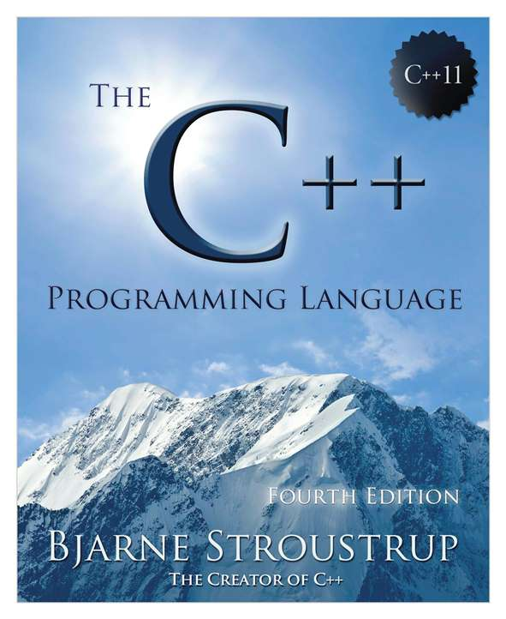
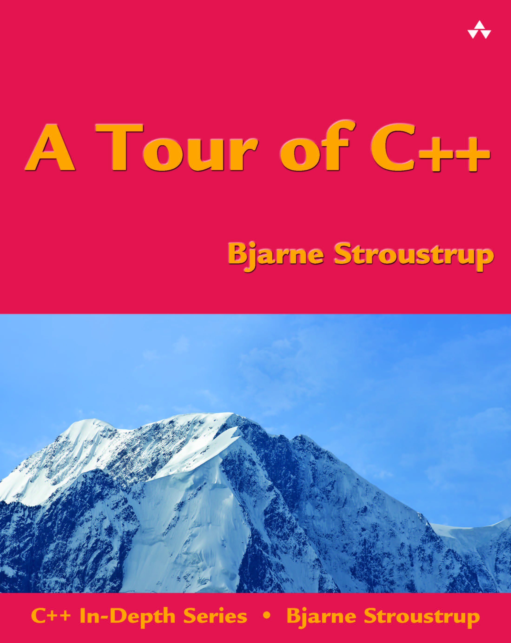
C++11
Compilers (all free)
  GCC
  Clang
  VC++
  …
Books
  TC++PL4 (complete)
  Tour++ (short overview)
  …
Websites
  http://www.stroustrup.com/C++11FAQ.html
  http://en.wikipedia.org/wiki/C++11
  …
Videos
  http://channel9.msdn.com/Events/GoingNative/2013/Opening-Keynote-Bjarne-Stroustrup
  http://www.swansea.ac.uk/compsci/distinguishedlectures/bjarnestroustrup/
  …
Stroustrup/PPP - Nov'13

Slide 41
A great link
http://www-gap.dcs.st-and.ac.uk/~history/
  A great link for anyone who likes math
    Or simply needs to use math
  Famous mathematicians
    Biography, accomplishments, plus curios,
    for example, who is the only major mathematician to win an Olympic medal?
  Famous curves
  Famous problems
  Mathematical topics
    Algebra
    Analysis
    Numbers and number theory
    Geometry and topology
    Mathematical physics
    Mathematical astronomy
  The history of mathematics
  …
Stroustrup/PPP - Nov'13

